Slide 1

Introduction to Service Fabric
dev up - 2016
Presented By: someone that still plays with cars
https://aka.ms/brent-servicefabric-intro
Notes:
Do introduction

Slide 2
I always wanted to put a sign up on the road to Yale saying, ‘Beware: Deconstruction Ahead.’
Gloria Steinem – American Activist
Notes:
Obligatory quote from someone famous. This seemed as good as anything else.

Slide 3
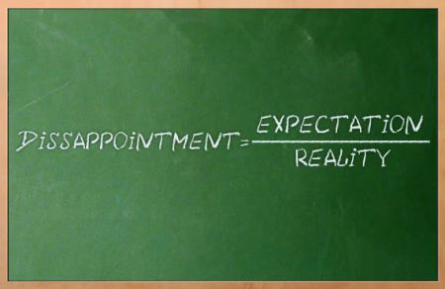
Setting Expectations
In-tro-duc-tion
Explain ‘what this is’
Both Code and Infrastructure
Together you get a clearer picture
DevOps
Configuration Through Code
Notes:
Introduction
The intent is to make you comfortable explaining to others at a high level what Service Fabric and Microservice Architectures are. If you are already actively working with Service Fabric, this likely isn’t the session for you.
Code and the Infrastructure
SvcFab is both the best and worst of IaaS and PaaS. It’s a powerful orchestration framework for microservices, but to leverage it fully, you also need to understand the infrastructure that supports it and how these two fit together.
DevOps
Service Fabric drags you kicking and screaming into the world of DevOps. You’ll need to understand the concept of configuration through code and how that impacts not just building your services, but also how they are deployed.
image from: https://thetechbench.wordpress.com/category/client-expectations/

Slide 4
Traditional application a.k.a Monolith
Compile-time contract validation
Local operations
Easier to reason about
Expensive to scale application
Hard to scale data access
Upgrades are a big deal
Notes:
For years we’ve been building n-tier applications. The influence of the “monolith” architectural style cannot be dismissed. This model, while this approach did solve some of the challenges of large scale solution development…
Communication contracts with compile time validation
Localized, internal communications
Discoverability… easy to understand, locate necessary functionality
But this approach does present some new challenges.
Monolithic solutions, while providing a separation of concerns, still results in the individual portions of an application being more tightly bound then their builders ever intended. This means that making significant changes is expensive and complicated. It also makes it more difficult to perform upgrades of individual portions of the system. It also presents challenges for scaling the solution if a limited number of aspects of the solution are the ones being overloaded.

Slide 5
Challenges of creating applications
Fragile environment
Webscale
Distributed teams
Frequent upgrades
Notes:
But the challenges don’t end there…
Monolithic solutions become fragile over time. They seem to breed dependencies between facets of the solution as well as the environment they are deployed in.
This type of architecture was born on-prem, in an “scale up” world. As such, they have difficulties trying to “scale out” when you try to turn them into externally consumable services.
When these solutions are not developed in a specific geography, but instead pulled together by teams spread around the globe, the dependencies are emphasized, and start to impede work getting done.
And as I’m sure some of you are well aware, these “technological terrors” are VERY difficult to upgrade frequently. Often there are detailed, complex plans required to perform upgrades and as a result you might update a solution only once or twice a year.

Slide 6

stateless
presentation services
Tiers of specific technologies
stateful
services
Single monolithic
database
stateless services
with
separate stores
Notes:
But solutions have evolved to try and address these issues. 10+ years ago, there was SOA which provided its own set of challenges. But recently a new standard has emerged, microservices.
By deconstructing the tiers of the monolithic application into smaller, more discrete services, we are able to decouple them, and allow us to manage and maintain them individually.

Slide 7
Microservices
Definition
Application created by connecting small, specialized services
Use bounded context that’s easily understandable
Use versioned interfaces for services
Service lifecycle owned by a small team
Benefits
Services are loosely coupled and independently deployable
Rapid development, innovation
Partitioned for scale and availability
Testability
Notes:
There are a significant amount of debate (mostly academic) about what exactly a microservice is. I’d caution you not to get too caught up in all this, and instead look at various approaches and find one that works best for you.
That said, there are some fairly common attributes:
An application is composed of multiple small, almost atomic services that each do one thing well
A service is specific to a bounded context (models of the business domain), providing a logical grouping of functionality
Services are clearly versioned.
The lifecycle of a service is owned by a small team, allowing them to remain agile and work independently of other services
The benefits will depend in large part on your implementation. But what you’re striving for is:
Loosely coupled, independent services that are easily deployable (few dependencies)
With such a small team and narrow functional scope, development cycles are short and agile. This increases the rate of development, delivery, and subsequently innovation
With this degree of granularity, it becomes much easier to validate the functionality of each service. And with versioning, you can ensure that backwards compatibility is maintained.
Notes
Bounded Context: http://martinfowler.com/bliki/BoundedContext.html

Slide 8
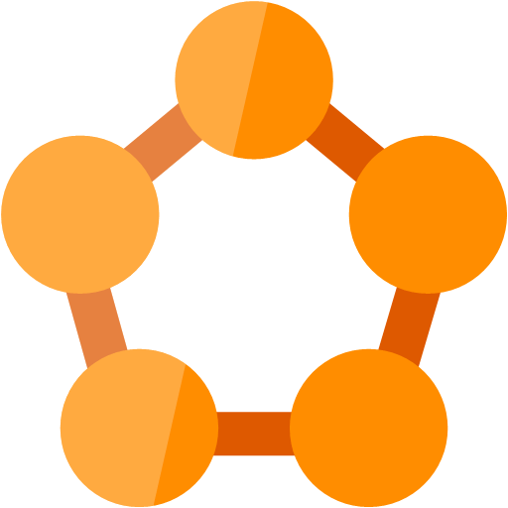
And from this was born Service fabric
An orchestration framework
A way to run, and manage microservices across a cluster of servers
Started Internally
Born inside Microsoft to build “cloud scale” solutions
Used by many of the most broadly used Azure and Office 365 services
Notes:
Elasticity scale-in scale-out / if needed scale up and down

Slide 9
Service Fabric
LifecycleMgmt
Independent Scaling
Independent Updates
Always On Availability
Resource Efficient
Stateless/
Stateful
Public Cloud
Other Clouds
Private cloud
Notes:
Next generation of PaaS on Azure
Elastic scale, OS updates, SF updates
Microservices platform for Windows and Linux
DevOps, rolling upgrades, etc.
Polycloud including on-premises
Programming models
Stateless Win32 apps written in any language (some feature not supported)
Reliable Services: Stateless & stateful (for hot data; gives low-latency reads)
OWIN/ASP.NET Core*
Service Fabric is free of charge
SDK: http://aka.ms/ServiceFabricSDK

Slide 10
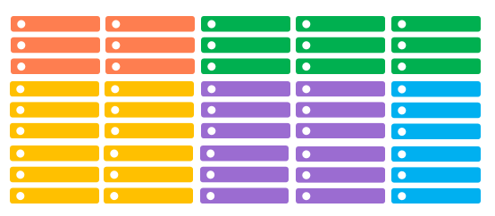
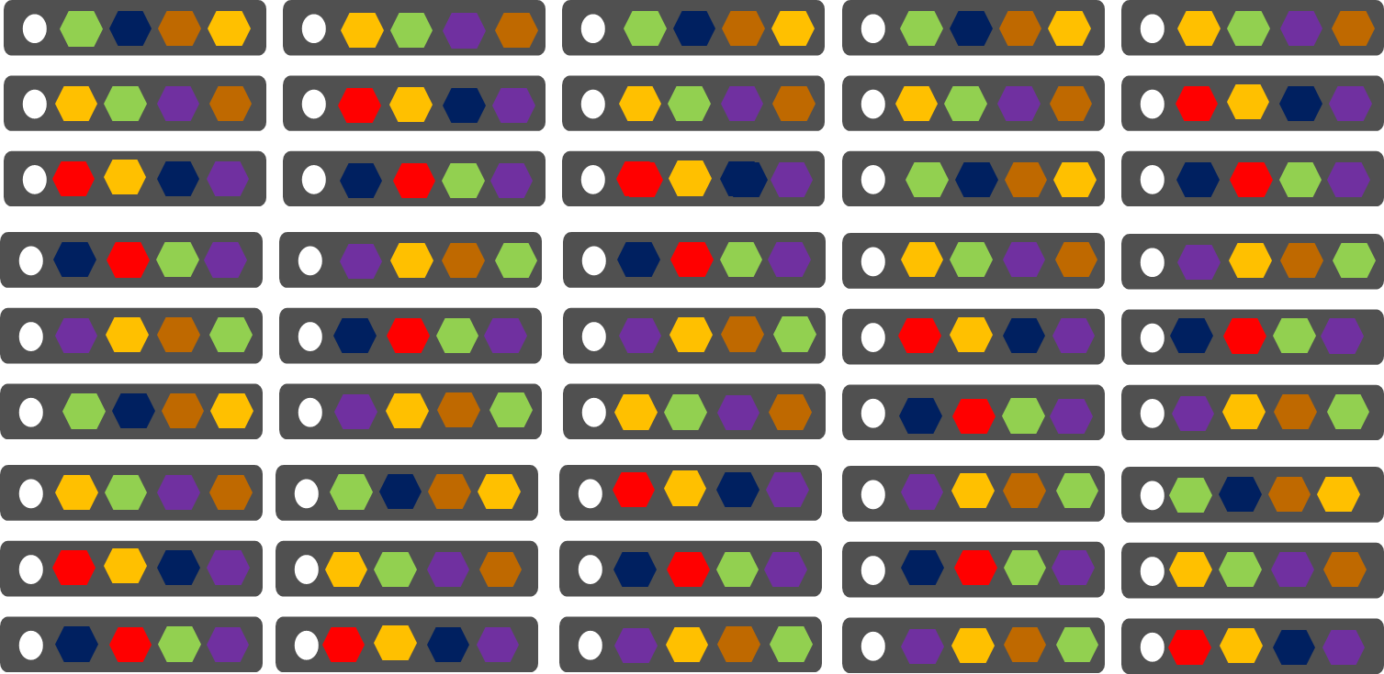
Conventional Services
Service Fabric
1 instance per VM
Uneven utilization
Low density
Slow deployment & upgrade (bound to VM)
Slow scaling and failure recovery
Limited fault tolerance
Many microservices per VM
Even Utilization (by default, customizable)
High density (customizable)
Fast deployment & upgrade
Fast scaling of independent microservices
Tunable fast fault tolerance

Slide 11

Service Fabric Cluster
Ckuster supports 1,000s of nodes
is self repairing, and scales-up or down
Datacenter (Azure, Amazon, On-Premises)
PC/VM #2
Service Fabric
Your code, etc.
PC/VM #3
Service Fabric
Your code, etc. (Port: 19080)
PC/VM #1
Your code, etc.
Service Fabric
PC/VM #4
Load Balancer
Your code, etc.
Service Fabric
Your code, etc.
PC/VM #5
Web Request (Port: 80/443/?)
Service Fabric
Your code, etc.
Notes:
Box representing cloud
Contains Cluster (can contain 1000s of nodes)
Contains Nodes (@ has name)
Endpoints
HttpGateWay (19007), Cluster (tcp: 19000)?
Your “static” code/data/config
Load Balancer
Animate: start w/DC box
Enter some nodes (names)
Install OS/SF
Establish endpoints to create cluster
You code/data/config
Load Balancer
Client request → LB → to a node
---
<?xml version="1.0" encoding="utf-8"?>
<!--
WARNING WARNING WARNING WARNING WARNING WARNING WARNING WARNING WARNING WARNING WARNING
WARNING WARNING WARNING WARNING WARNING WARNING WARNING WARNING WARNING WARNING WARNING
WARNING WARNING WARNING WARNING WARNING WARNING WARNING WARNING WARNING WARNING WARNING
The settings used within this ClusterManifest are expressly for use only
within a developer single-box environment. Any use of these settings outside
of that environment are highly likely to produce incorrect, and misperforming
systems.
WARNING WARNING WARNING WARNING WARNING WARNING WARNING WARNING WARNING WARNING WARNING
WARNING WARNING WARNING WARNING WARNING WARNING WARNING WARNING WARNING WARNING WARNING
WARNING WARNING WARNING WARNING WARNING WARNING WARNING WARNING WARNING WARNING WARNING
-->
<ClusterManifest
xmlns:xsd="http://www.w3.org/2001/XMLSchema"
xmlns:xsi="http://www.w3.org/2001/XMLSchema-instance"
xmlns="http://schemas.microsoft.com/2011/01/fabric"
Name="ComputerName-Local-Cluster"
Version="1.0">
<NodeTypes>
<NodeType Name="NodeType1">
<Endpoints>
<ClientConnectionEndpoint Port="19000" />
<LeaseDriverEndpoint Port="19001" />
<ClusterConnectionEndpoint Port="19002" />
<HttpGatewayEndpoint Port="19007" Protocol="http" />
<ServiceConnectionEndpoint Port="19006" />
<ApplicationEndpoints StartPort="30001" EndPort="31000" />
</Endpoints>
</NodeType>
<NodeType Name="NodeType2">
<Endpoints>
<ClientConnectionEndpoint Port="19010" />
<LeaseDriverEndpoint Port="19011" />
<ClusterConnectionEndpoint Port="19012" />
<HttpGatewayEndpoint Port="19017" Protocol="http" />
<ServiceConnectionEndpoint Port="19016" />
<ApplicationEndpoints StartPort="31001" EndPort="32000" />
</Endpoints>
</NodeType>
<NodeType Name="NodeType3">
<Endpoints>
<ClientConnectionEndpoint Port="19020" />
<LeaseDriverEndpoint Port="19021" />
<ClusterConnectionEndpoint Port="19022" />
<HttpGatewayEndpoint Port="19027" Protocol="http" />
<ServiceConnectionEndpoint Port="19026" />
<ApplicationEndpoints StartPort="32001" EndPort="33000" />
</Endpoints>
</NodeType>
<NodeType Name="NodeType4">
<Endpoints>
<ClientConnectionEndpoint Port="19030" />
<LeaseDriverEndpoint Port="19031" />
<ClusterConnectionEndpoint Port="19032" />
<HttpGatewayEndpoint Port="19037" Protocol="http" />
<ServiceConnectionEndpoint Port="19036" />
<ApplicationEndpoints StartPort="33001" EndPort="34000" />
</Endpoints>
</NodeType>
<NodeType Name="NodeType5">
<Endpoints>
<ClientConnectionEndpoint Port="19040" />
<LeaseDriverEndpoint Port="19041" />
<ClusterConnectionEndpoint Port="19042" />
<HttpGatewayEndpoint Port="19047" Protocol="http" />
<ServiceConnectionEndpoint Port="19046" />
<ApplicationEndpoints StartPort="34001" EndPort="35000" />
</Endpoints>
</NodeType>
</NodeTypes>
<Infrastructure>
<WindowsServer IsScaleMin="true">
<NodeList>
<Node NodeName="Node.1" IPAddressOrFQDN="localhost" IsSeedNode="true" NodeTypeRef="NodeType1" FaultDomain="fd:/FD01" UpgradeDomain="UD1" />
<Node NodeName="Node.2" IPAddressOrFQDN="localhost" IsSeedNode="true" NodeTypeRef="NodeType2" FaultDomain="fd:/FD02" UpgradeDomain="UD2" />
<Node NodeName="Node.3" IPAddressOrFQDN="localhost" IsSeedNode="true" NodeTypeRef="NodeType3" FaultDomain="fd:/FD03" UpgradeDomain="UD3" />
<Node NodeName="Node.4" IPAddressOrFQDN="localhost" IsSeedNode="false" NodeTypeRef="NodeType4" FaultDomain="fd:/FD04" UpgradeDomain="UD1" />
<Node NodeName="Node.5" IPAddressOrFQDN="localhost" IsSeedNode="false" NodeTypeRef="NodeType5" FaultDomain="fd:/FD05" UpgradeDomain="UD2" />
</NodeList>
</WindowsServer>
</Infrastructure>
<FabricSettings>
<Section Name="Security">
<Parameter Name="ClusterCredentialType" Value="None" />
<Parameter Name="ServerAuthCredentialType" Value="None" />
</Section>
<Section Name="FailoverManager">
<!-- expected cluster size allows the placement to start when the cluster is started. This value should be less than total number of nodes
as without it the FailoverManager will not start the placement of the user services. This value should be 80% to 90% of the cluster size.
-->
<Parameter Name="ExpectedClusterSize" Value="4" />
<!-- The default target and min replica set sizes are 7 and 5. The below configuration is not required for cluster that have 7 or more nodes. -->
<Parameter Name="TargetReplicaSetSize" Value="5" />
<Parameter Name="MinReplicaSetSize" Value="3" />
<Parameter Name="ReconfigurationTimeLimit" Value="20" />
<Parameter Name="BuildReplicaTimeLimit" Value="20" />
<Parameter Name="CreateInstanceTimeLimit" Value="20" />
<Parameter Name="PlacementTimeLimit" Value="20" />
</Section>
<Section Name="ReconfigurationAgent">
<Parameter Name="ServiceApiHealthDuration" Value="20" />
<Parameter Name="ServiceReconfigurationApiHealthDuration" Value="20" />
<Parameter Name="LocalHealthReportingTimerInterval" Value="5" />
<Parameter Name="IsDeactivationInfoEnabled" Value="true" />
</Section>
<Section Name="ClusterManager">
<!-- The default target and min replica set sizes are 7 and 5. The below configuration is not required for cluster that have 7 or more nodes. -->
<Parameter Name="TargetReplicaSetSize" Value="5" />
<Parameter Name="MinReplicaSetSize" Value="3" />
<Parameter Name="UpgradeStatusPollInterval" Value="5" />
<Parameter Name="UpgradeHealthCheckInterval" Value="5" />
<Parameter Name="FabricUpgradeHealthCheckInterval" Value="5" />
</Section>
<Section Name="NamingService">
<!-- The default target and min replica set sizes are 7 and 5. The below configuration is not required for cluster that have 7 or more nodes. -->
<Parameter Name="TargetReplicaSetSize" Value="5" />
<Parameter Name="MinReplicaSetSize" Value="3" />
</Section>
<Section Name="Management">
<Parameter Name="ImageStoreConnectionString" Value="file:C:\SfDevCluster\Data\ImageStore" />
<Parameter Name="ImageCachingEnabled" Value="false" />
</Section>
<Section Name="Hosting">
<Parameter Name="EndpointProviderEnabled" Value="true" />
<Parameter Name="RunAsPolicyEnabled" Value="true" />
<Parameter Name="DeactivationScanInterval" Value="60" />
<Parameter Name="DeactivationGraceInterval" Value="10" />
<Parameter Name="EnableProcessDebugging" Value="true" />
<Parameter Name="ServiceTypeRegistrationTimeout" Value="20" />
<Parameter Name="CacheCleanupScanInterval" Value="300" />
</Section>
<Section Name="HttpGateway">
<Parameter Name="IsEnabled" Value="true" />
</Section>
<Section Name="PlacementAndLoadBalancing">
<!-- balance the load on the cluster every 5 minutes. -->
<Parameter Name="MinLoadBalancingInterval" Value="300" />
</Section>
<Section Name="Federation">
<Parameter Name="NodeIdGeneratorVersion" Value="V3" />
</Section>
<Section Name="Trace/Etw">
<Parameter Name="Level" Value="4" />
</Section>
<!-- Configure the DCA to cleanup the log folder only. The collection of the logs, performance counters and crashdumps is not performed on the local machine. -->
<Section Name="Diagnostics">
<Parameter Name="ProducerInstances" Value="ServiceFabricEtlFile, ServiceFabricPerfCtrFolder" />
<Parameter Name="MaxDiskQuotaInMB" Value="10240" />
</Section>
<Section Name="ServiceFabricEtlFile">
<Parameter Name="ProducerType" Value="EtlFileProducer" />
<Parameter Name="IsEnabled" Value="true" />
<Parameter Name="EtlReadIntervalInMinutes" Value=" 5" />
<Parameter Name="DataDeletionAgeInDays" Value="3" />
</Section>
<Section Name="ServiceFabricPerfCtrFolder">
<Parameter Name="ProducerType" Value="FolderProducer" />
<Parameter Name="IsEnabled" Value="true" />
<Parameter Name="FolderType" Value="WindowsFabricPerformanceCounters" />
<Parameter Name="DataDeletionAgeInDays" Value="3" />
</Section>
<Section Name="TransactionalReplicator">
<Parameter Name="MaxStreamSizeInMB" Value="64" />
</Section>
</FabricSettings>
</ClusterManifest>

Slide 12
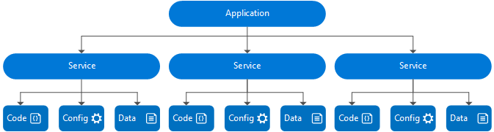
Application composition

Slide 13
Application composition
An application:
Is a logical grouping of services
Is an upgrade unit. An upgrade targets an application instance
Can have different versions of the same application type side-by-side
instances of the same type get their own processes

Slide 14
Application composition
A service:
Is a logical grouping of partitions (and replicas/instances)
Is upgraded as part of an application upgrade*
Can not have different versions of the same service type within an application
instances of the same type share a process
*(but you can choose which services to upgrade)

Slide 15
Application type
Declarative template for creating an application
Based on a set of service types
Used for packaging, deployment, and versioning
Application Type A
Service Type 1
Service Type 2
Service Type 3
Code
Config
Data
Code
Config
Data
Code
Config
Data

Slide 16
Service type
Services types are composed of code/config/data packages
Code packages define an entry point (dll or exe)
Config packages define service specific config information
Data packages define static resources (eg. images)
Packages can be independently versioned
<ServiceManifest Name="QueueService" Version="1.0">
<ServiceTypes>
<StatefulServiceType ServiceTypeName="QueueServiceType" HasPersistedState="true" />
</ServiceTypes>
<CodePackage Name="Code" Version="1.0">
<EntryPoint>
<ExeHost>
<Program>ServiceHost.exe</Program>
</ExeHost>
</EntryPoint>
</CodePackage>
<ConfigPackage Name="Config" Version="1.0" />
<DataPackage Name="Data" Version="1.0" />
</ServiceManifest>
Service Type 1
Code
Config
Data

Slide 17
Types of microservices from a Service Fabric perspective
Stateless microservice
Has either no state or it can be retrieved from an external store
There can be N instances
e.g. web frontends, protocol gateways, Azure Cloud Services etc.
Stateful microservice
Maintain hard, authoritative state
N consistent copies achieved through replication and local persistence
e.g. database, documents, workflow, user profile, shopping cart etc.
Notes:
Stateless services are identical to Worker roles in Cloud Services.
Stateful services are about bringing HA the programming model and democratizing HA for everyone. Service Fabric is a storage layer where the “hot” data that needs to be held close to compute is managed in statefull services.

Slide 18





Defining applications and services
Code
Config
Application Type
Application
Package
Counter
Service type
Unit of
Lifetime
Versioning
Isolation
Counter WebApp type
Counter
Service
Pkg
Counter
WebApp
Pkg

Slide 19
Instantiating an application
app1
app2
Service
Package
A
Service
Package
A
Service
Package
B
Service
Package
B
app3
app4
Service
Package
A
Service
Package
A
Service
Package
B
Service
Package
B
ServiceType is “like” a class type
ApplicationType is “like” a typed Container
Each service instance has a unique name in the “namespace” of the application “fabric:/CounterApplication/CounterService”
ApplicationInstance is an instance of the ApplicationType and has an unique name “fabric:/CounterApplication”

Slide 20
Reliable Services API
Build stateless services using existing technologies such as ASP.NET.
Manage concurrency and granularity of state changes with transactions in stateful services.
Communicate with services using the technology of your choice (e.g Web API, WCF, [web]sockets, etc).

Slide 21
Reliable Collections
Reliable collections make it easy to build stateful services.
An evolution of .NET collections for the cloud.
Collections
Single machine
Single threaded
Concurrent
Collections
Single machine
Multi threaded
Reliable Collections
Multi machine
Replicated (HA)
Persistence (durable)
Asynchronous
Transactional

Slide 22


Reliable Collections
IReliableDictionary<K,V>
IReliableQueue<T>
Data is replicated and durably stored on multiple replicas.
Atomically update one or more collections using transactions.
Reads are repeatable within the transaction.
Enumerations are snapshot based.
Supports LINQ.

Slide 23
Service Fabric Orchestration - Rules
Fault and Upgrade Domains (topology awareness)
Fault Domains -> Areas of Independent, Uncorrelated Failures: Power Sources, etc
Upgrade Domains -> No Downtime Rolling Upgrades
Placement Constraints
Tag nodes with properties and values
Select specific workloads for certain nodes, ex: (HasGPU == True)
Node Capacity
Don’t overload nodes
React to changes in resource consumption
React to overloaded nodes quickly

Slide 24
Service Fabric Orchestration - Optimizations
Default Metrics
Prevent basic workloads from clumping up in the cluster
Custom Metrics
Allow applications to define resources they care about, balance them in the cluster to prevent hot/cold nodes
Metric Weights
Preferences for fixing one metric vs. another, ex: “Memory is More Important than Disk for this Service”
Proactive Rebalancing w/ Triggers
“The cluster may be only so imbalanced before Service Fabric should react”
Movement Cost
Some Services are smaller and easier to move
If we can fix issues in the cluster without moving the “big” workloads, prefer these solutions

Slide 25
Service Fabric – failover
X
Failed
Types of reconfiguration
Primary failover
Removing a failed secondary
Adding recovered replica
Building a new secondary
Replica States
None
Idle Secondary
Active Secondary
Primary
P
S
P
B
S
X
S
Failed
S
S
Must be safe in the presence of cascading failures

Slide 26
On Applications, Hosts & Activation
Applications are packages, copied to the cluster (System:Image Store Service), then registered as ApplicationType and ApplicationTypeVersion with Service Fabric.
Application instance is based on ApplicationType & ApplicationTypeVersion defines process isolation boundaries, while partition defines data isolation boundaries.
ApplicationManifest’s DefaultServices are activated with every app instance.
VS.NET tooling creates 1 App Instance when you F5 or Publish.
Services are defined as a ServiceType with ServiceTypeVersion in a Service Package that also has Code, Config & Data packages (each package is versioned).
Code = host, host is a process created per node per Application per service type. Optionally: can also have a Setup EntryPoint. Replicas are activated in host process.
Notes:
Stephane

Slide 27
On Rolling Upgrades
Hosts are taken down during Code package updates, but not during Config or Data packages upgrades.
Upgrades are performed on Cluster Update Domains.
Upgrades Types
Monitored Auto: UD one by one , health checks and failure action: (can do auto roll back).
Unmonitored Auto: UD one by one, no health checks.
Unmonitored Manual: You manually upgrade each UD.
* use Upgrade Parameters to control the upgrade process.
Notes:
Stephane

Slide 28
Application Upgrade
Upgrade Domain #1
Upgrade Domain #2
Upgrade Domain #3
App Repository
Windows OS
Windows OS
App A v1
Windows OS
App C v2
App A v1
App C v1
Fabric
Node
App B v2
Fabric
Node
Fabric
Node
App B v2
App C v2
App C v1
App C v1
App C v2
Windows OS
Windows OS
Windows OS
Fabric
Node
App B v2
App C v2
App B v2
App C v1
Fabric
Node
App A v1
App A v1
Fabric
Node
Notes:
Stephane

Slide 29
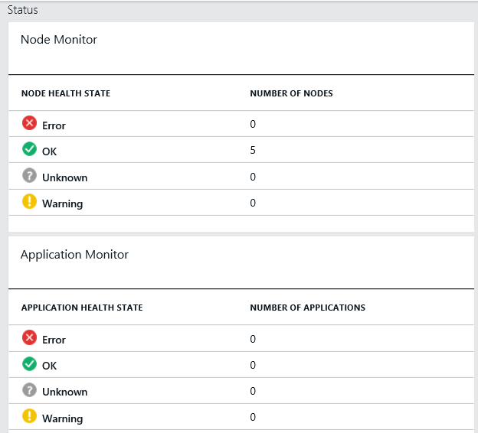
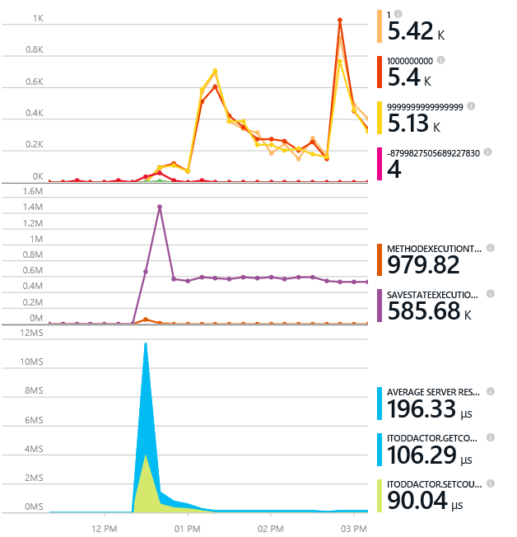
Monitoring your Services
Health status monitoring
Built-in health status for cluster and services
Flexible and extensible health store for custom app health reporting
Allows continuous monitoring for real-time alerting on problems in production
Performance and stress response
Rich built-in metrics for Actors and Services programming models
Easy to add custom application performance metrics

Slide 30
Diagnostics and Troubleshooting
Detailed System Optics
Repair suggestions. Examples: Slow RunAsync cancellations, RunAsync failures
All important events logged. Examples: App creation, deploy and upgrade records. All Actor method calls.
Custom Application Tracing
ETW == Fast Industry Standard Logging Technology
Works across environments. Same tracing code runs on devbox and also on production clusters on Azure.
Easy to add and system appends all the needed metadata such as node, app, service, and partition.
Choice of Tools
Visual Studio Diagnostics Events Viewer
Windows Event Viewer
Windows Azure Diagnostics + Operational Insights
Easy to plug in your preferred tools: Kibana, Elasticsearch and more

Slide 31

A Platform for Microservices is not Free
Problems to Solve
Service Availability
Resource Allocation
State Management
Versioning
Independently upgradable services / data
Roll backs
You provide the design & code
You can still write monolithic applications and do bad things!

Slide 32
Interested in More?
https://aka.ms/brent-servicefabric-intro
Content © Microsoft
Notes:
Too many learning materials to list here. I’ve put some of my favorites on my blog along with a link to this presentation. Enjoy and check back for updates as things continue to mature.

Slide 33

Thank you!
https://aka.ms/brent-servicefabric-intro
Brent Stineman
DX/TED, Azure Specialist, Cloud Evangelist
Email: brestin@microsoft.com
Twitter: @brentcodemonkey
Web: http://brentdacodemonkey.wordpress.com
→
Creating quality bugs since 1992!
Notes:
Image Courtesy of Brent.
Purple dye all over his face is courtesy of his daughter

